Slide 1
Chapter 6
Array

Slide 2

Introduction
Question
How to deal with scores of a class?
How to store a string?
How to describe a matrix?
We have learned basic data types (int, char, float and double), but all cannot solve the above problems.
C language defines a new data type: array (数组) to describe above data.

Slide 3

Think about this question:
Input those marks obtained by 10 students in a test, write a
program to find the average and total marks.
#include <stdio.h>
void main()
{
int mark1,mark2,mark3,mark4,mark5;
int mark6,mark7,mark8,mark9,mark10;
int sum;
float aver;
printf(“please input ten marks”):
scanf(“%d, %d, %d, %d, %d”, &mark1,&mark2,&mark3,&mark4,&mark5);
scanf(“%d, %d, %d, %d, %d”, &mark6,&mark7,&mark8,&mark9,&mark10);
sum = mark1+mark2+mark3+mark4+mark5
+ mark6+mark7+mark8+mark9+mark10;
aver = sum /10.0;
printf(“the total and average marks are %d,%f”,sum,aver);
}
Is that troublesome? How about 50 students?
Any better way
to solve it ?

Slide 4
Introduction
Question:
How to make a series of integers in increasing order?
8
8
1
2
9
4
5
6
3
7
7
1
1
8
6
8
8
8
8
8
8
8
8
array
8
8
1
1
How to store these integers?
After sorting, How to store them keeping in order?
8
swap

Slide 5
Array concept：
一组具有相同数据类型的数据的有序集合
Consecutive storage, same type, subscript control
m[2]
3
7
4
6
5
memory
m[0]
m[1]
m[2]
m[99]
Accessed by subscript
one variable name
application: string processing

Slide 6
e.g：存储学生成绩用整型数组 int mark[100];
存储一行文字用字符数组 char str[200];
存储一个4*6的矩阵用二维整型数组 int a[4][6];
mark、str、a 是数组名。
方括号内是数组的长度
下标的个数称为数组的维数(array dimension)
  mark、str是一维数组, a是二维数组
数组的成员称为数组元素(Array elements )
数组元素的类型称为该数组的基类型(Array base type )
  数组mark的基类型是int , 数组str的基类型是char

Slide 7
Array
An array is a data structure - features that used to simplify programming tasks
grouping of same type data continuously
Example application - a list of temperatures recorded every hour of a particular weather station for one year

Slide 8
Array definition and accessing
The same type
Array
Limited numbers
Store in sequence
To group several data with the same type together

Slide 9
Array definition and accessing
How many members in array. Size is constants.
Declaring an array
data type array-name [ size ]
All array members are the same type
Example: int a [ 10 ];
float score[20];
int matrix[10][10];
Array can have more than 1 dimension.

Slide 10
Several typical errors in array declaration
① float a[0];
② int b(2)(3);
③ int k, a[k];
④ int n;
scanf (”%d”, &n);
int a[n];
/* 数组大小为0没有意义 */
/* 不能使用圆括号 */
/* 不能用变量说明数组大小 */
C语言不允许对数组的大小进行动态说明
数组的说明语句必须在可执行语句之前

Slide 11
Array definition and accessing
Accessing array members
from 0 to size-1
array-name [ subscript ]
memory
a[0]
Example: int a [ 10 ];
a[0], a[1], a[2]… a[9]
a[1]
a[2]
a[3]
a[4]
a[5]
Notes:
An array element is equivalent to an ordinary variable functionally.
a[6]
a[7]
a[8]
a[9]

Slide 12
优点：数据重用
数据有序
引用数组元素的注意事项:
  数组中的每个元素在功能上等价于一个一般的变量
  例如：输入100个学生成绩，并求出总成绩。
简单变量
x
85
  float x, sum=0;
  for (i=0; i<100; i++)
  { scanf(”%f\n”, &x);
  sum += x;
  }
82
63
sum
85
7950
148
m[0]
m[1]
m[2]
m[99]
85
63
78
90
float m[100],sum=0;
for ( i=0; i<100; i++ )
{ scanf(”%f\n”, &m[i]);
sum += m[i];
}
数组方式
82
sum
85
7950
148
226
316

Slide 13
Array definition and accessing
Initialize array
一般方法：
int a[10]={1,2,3,4,5,6,7,8,9,10};
初始化部分元素:
float x[5] = { 1.9, 2.0 }; // other elements be assigned 0.
根据数据定义数组长度:
int b[ ] = {1, 2, 3, 4};// 4 elements in array b
动态输入数组值：
int i；
for(i=0;i<10;i++)
scanf(“%d”,&a[i]);
Example:

Slide 14
Array definition and accessing
Example1: Enter the 100 student’s score for Data Structure and Algorithm course, then calculate the average score and display it.
#define STUNUM 100
void main{
float score[STUNUM],sum=0,average;
int studentNum = STUNUM;
for ( i=0; i< studentNum; i++ )
{ scanf(”%f”, &score[i]);
sum += score[i];
}
average = sum/ studentNum ;
printf(“The average score for Data
Structure and Algorithm course is
%f.\n”, average);
}
Array storage
m[0]
m[1]
m[2]
m[99]
85
63
78
90
82
sum
79.5

Slide 15
数组在内存中的存放
一维数组： float mark[100];
低地址
高地址
86.5
92.0
77.5
52.0
.
.
.
94.0
mark[0]
mark[1]
mark[2]
mark[3]
.
.
.
mark[99]
每个数据元素占用的字节数，就是基类型的字节数
一个元素占4个字节

Slide 16
一维数组的引用
2000_{H}
2004_{H}
2008_{H}
200C_{H}
.
.
.
218C_{H}
86.5
92.0
77.5
52.0
.
.
.
94.0
mark[0]
mark[1]
mark[2]
mark[3]
.
.
.
mark[99]
（1）下标与地址的关系
[ ] 为下标运算符, 数组名、数组元素是两种不同性质的数据。
数组名是数组的首地址，是一个地址常量！
数组元素则是数值。
如引用 mark[2]:
(1)计算 2000+2*4
即：mark+ 2*4
(2)取出2008的内容
引用数组元素时，给出该元素的地址，取出该地址的内容进行操作。即：
mark [2] 或 *(mark+2)

Slide 17
（2）对于非字符数组按元素访问
输入/输出数组：int x[10];
正确：for (k=0; k<10; k++)
    scanf (”%d”, &x[k]);
for (k=0; k<=9; ++k)
    printf (”%d\n”, x[k]);
错误： scanf (”%d%d%d%d%d%d%d%d%d%d”, x);
scanf (”%d”, x);
printf (”%d”, x);
printf (”%d%d%d%d%d%d%d%d%d%d”, x);
（3）对于字符数组可进行整体访问
scanf(”%s”, string);
printf (”%s”, string);

Slide 18
Example 2: Calculate the value of the first thirty items
(N=30) of Fibonacci list. a₁=a₂=1 a_{n}=a_{n-1}+a_{n-2} i.e.: 1,1,2,3,5,8,13
Array definition and accessing
  #define NUM 30
  void main( ) {
  int fiboList[NUM];
  fiboList[0] = 1; fiboList[1] = 1;
  int i;
  for (i=2; i<NUM; ++i)
  fiboList [i] = fiboList [i-1]+fiboList [i-2];
  for (i=0; i<NUM; i++)
  printf("%d\t", fiboList[i]);
  }

Slide 19

Array
#define N 10
void main (void)
{
int a[2];
double b[N];
a[0] = 11;
a[1] = 22;
b[3] = 777.7;
b[6] = 888.8;
printf ("a[0] = %3d, a[1] = %3d\n", a[0], a[1]);
printf ("b[3] = %8.2lf, b[6] = %8.2lf \n", b[3], b[6]);
printf ("b[2] = %lf\n", b[2]);
printf ("a[3] = %d\n", a[3]);
}
Output

Slide 20
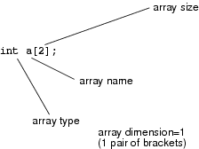
One-dimensional array
To declare a one-dimensional(1D) array
element_type array_name [number_of_elements];

Slide 21
1D Array
To name an array - follow the rules used for naming identifiers
How do we distinguish between a 1-D array and 2- or 3-D arrays?
1D array has only one pair of brackets [ ]. A 2D array has two pairs, and a 3D array has three pairs, and so on.
How do we set the length of a 1-D array?
determined by result of expression enclosed in brackets in declaration. E.g.
int a[2], c[20+4], g[100];
or
#define N 10
double b[N];
Note : size must be constant

Slide 22
1D Array
Index (subscript) of an array :
integer to designate a particular element in the array
the first subscript is 0
Thus size-1 is the maximum subscript.
C does not check array bound i.e.
int a[2];
a[2] = 101; // this will be compiled & executed
C would actually go to the memory location after a[1] and extract a value
Programmers’ responsibility to be very careful to not exceed the size of array

Slide 23
1D Array
treat an array element like we treat a single variable e.g.
printf("a[0] = %3d, a[1] = %3d\n", a[0],a[1]);
Initialization
int a[3]={11,22}, b[]={44, 55, 66};
Declare the array with size, and immediately set values of some of the array elements (with index 0, 1)
Declare the array without size and immediately set values of the array elements in braces. Size will be the number of listed elements

Slide 24

BASIC ARRAY INPUT/OUTPUT
#include <stdio.h>
#include <math.h>
void main (void)
{
int i, j, k, num_elem;
double x[20], y[20], z[20];
FILE *infile, *outfile;
infile = fopen ("C6_3.IN", "r");
outfile = fopen ("C6_3.OUT", "w");
k = fscanf (infile, "%lf%lf", &x[0], &y[0]);
fprintf (outfile, "k = %d\n", k);
fprintf (outfile, "Value of EOF = %d\n", EOF);
i = 1;
while (fscanf (infile, "%lf%lf", &x[i], &y[i]) != EOF)
i++;
num_elem = i;
for (j=0; j<num_elem; j++)
{
z[j] = sqrt(x[j]*x[j]+y[j]*y[j]); fprintf (outfile, "%7.1f %7.1f %7.1f\n", x[j], y[j], z[j]);
}
fclose (infile);
fclose (outfile);
}
Input file C6_3.IN
3.0 4.0
6.0 8.0
9.0 12.0
Input file
Output

Slide 25
BASIC ARRAY INPUT/OUTPUT
read array data from a file use fscanf()
EOF
  a constant type macro defined in stdio.h
  if fscanf encounters the end of a file before it is able to read anything, returns EOF
useful when we want to read data from a file into an array and do not know how many values are in the data file
while (fscanf(infile,"%lf %lf",&x[i],&y[i])!= EOF) i++;
Typical array operations involve loop, e.g.
for (j=0; j<num_elem; j++)
{
z[j]=sqrt(x[j]*x[j]+y[j]*y[j]);
}

Slide 26
Two dimensional array
Declaring a two dimensional array
Data type array-name [ size1 ] [ size2 ]
Example: int matrix[3][3];
1 2 3
4 5 6
7 8 9

Slide 27
Two dimensional array
Accessing array members
Column, from 0 to size2-1
Row, from 0 to size1-1
array-name [ subscript1 ] [ subscript2 ]
memory
a[0][0]
Example: int a [ 3 ][3];
a[0][0], a[0][1], a[0][2]
…
a[2][0], a[2][1], a[2][2]
a[0][1]
a[0][2]
a[1][ 0]
a[1][ 1]
a[1][ 2]
a[2][ 0]
Storage row by row
a[2][ 1]
a[2][ 2]

Slide 28
多维数组的存储顺序:
第一维的下标变化最慢
如：int c[a₁][a₂]...[a_{n}]
低端
c[0][0]...[0][0]
c[0][0]...[0][1]
......
c[0][0]...[0][a_{n}-1]
c[0][0]...[1][0]
c[0][0]...[1][1]
......
c[0][0]...[1][a_{n}-1]
......
c[0][0]...[a_{n-1}-1][a_{n}-1]
......
高端
c[a₁-1][a₂-1]...[a_{n-1}-1][a_{n}-1]

Slide 29
Two dimensional array
Initialize array
int a[2][3]={ { 1,2,3 } , { 4,5,6 } };
int a[2][3]={1,2,3,4,5,6}；
int a[2][3]={{1},{2,3}}; // other elements be assigned 0
int a[2][3]={1,2,3}; // other elements be assigned 0
int a[2][3]={{0},{1,2,3}}; // other elements be assigned 0
for ( i=0 ; i< 2 ; i++ )
for ( j=0 ; j< 3 ; j++ )
scanf ( “%d”,&a[i][j] ) ;
Example:

Slide 30
对数组中的部分元素初始化，方法:
static int a[2][3] = { {1}, {4} };
结果为： a[0][0]=1, a[1][0]=4, 其余元素均为0。
static int a[3][3] = { {1,2}, { }, {4,5,6} };
结果为：a[0][0]=1, a[0][1]=2, a[2][0]=4,
a[2][1]=5, a[2][2]=6, 其余元素均为0。
对多维数组全部元素进行初始化时，可省略数组说明中第一维的大小。
例如： static int a[ ][3] = {1, 2, 3, 4, 5, 6};
注意：此时只能省略第 1 维的值。C根据初始化数据的
数量，自动确定第 1 维的大小。

Slide 31
二维数组的引用
（1）二维数组的地址
二维数组是数组的数组
二维数组名 a 表示二维数组的首地址
a[i] 表示i行一维数组的首地址
a+i 表示i行首地址
    a[i] ⇔ a+i ⇔ &a[i][0]
a[i]+j ⇔ &a[i][j]
a
a
a+1
a+2
a[0]
2
5
9
a[1]
3
2
5
a[2]
4
7
1

Slide 32
（2）按下标引用二维数组元素
void main( )
{ int a[2][3]={1,2,3,4,5,6}, i, j;
for(i=0;i<2;i++)
for(j=0;j<3;j++)
printf(“ %d \n”, a[i][j]);
}
（3）按数组名引用
i行首地址
printf(“ %d \n”, *(a[i]+j));
*(a[i]+j)
printf(“ %d \n”, a[i][j]);

Slide 33
MULTIDIMENSIONAL ARRAYS
#include <stdio.h>
void main (void)
{
int i, j, year, month, day;
int b[2][3]={51,52,53,54,55,56};
int rainfall[10][13][32];
FILE *infile;
infile = fopen ("L6_4.DAT", "r");
for (i=0; i<2; i++)
{
for (j=0; j<3; j++)
{
printf ("b[%1d][%1d]= %5d ", i, j, b[i][j]);
}
printf ("\n");
}
fscanf (infile, "%d %d", &year, &month);
for (day=1; day<=31; day++)
{
fscanf (infile, "%d", &rainfall[year][month][day]);
}
printf ("Rainfall for Year = %d, Month = %d\n\n", year, month);
for (day=1; day<=31; day++)
{
printf ("%d ", rainfall[year][month][day]);
if (day==7 || day==14 || day==21 || day==28)
printf ("\n");
}
}

Slide 34
MULTIDIMENSIONAL ARRAYS
Input file L6_4.DAT
4 12
0 2 0 29 0 1 2
3 0 7 22 11 12 6
0 3 4 2 8 7 5
7 6 0 4 9 7 8
1 9 8
Screen output
b[0][0]= 51 b[0][1]= 52 b[0][2]= 53
b[1][0]= 54 b[1][1]= 55 b[1][2]= 56
Rainfall for Year = 4, Month = 12
0 2 0 29 0 1 2
3 0 7 22 11 12 6
0 3 4 2 8 7 5
7 6 0 4 9 7 8
1 9 8

Slide 35
MULTIDIMENSIONAL ARRAYS
To declare a multidimensional array, additional set of brackets are used. e.g.
int b[2][3];
dimension to be 2 as two pairs of brackets [ ]
number of elements (size) is 2 x 3 = 6
To initialize a multidimensional array
int b[2][3]={51,52,53,54,55,56};
Initialized by row i.e.
b[0][0]= 51 b[0][1]= 52 b[0][2]= 53
b[1][0]= 54 b[1][1]= 55 b[1][2]= 56
Will produce the same results

Slide 36
MULTIDIMENSIONAL ARRAYS
Method 2 : to initialize a multidimensional array
int c[4][3]={{1, 2, 3},
{4, 5, 6},
{7, 8, 9},
{10,11,12}};
each row contained in a separate set of braces, C[0][0] = 1, c[0][1]=2 , etc.
Method 3
int c[4][3]={{1, 2},
{4, 5, 6},
{7},
{10,11,12}};
initializes c[0][2], c[2][1], and c[2][2] to be 0.
Method 4
int c[ ][3]={{1, 2, 3},
{4, 5, 6},
{7, 8, 9},
{10,11,12}};
implicitly declares the number of rows to be 4.

Slide 37
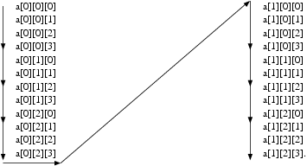
MULTIDIMENSIONAL ARRAYS
elements of multidimensional arrays are stored contiguously in increasing memory locations
The second element stored has all of its subscripts 0 except the far right, which has a value of 1, called row major
For example a 3D array a[2][3][4] will be arranged in memory as follow
CSC1510 COMPUTER PRINCIPLE & C PROGRAMMING

Slide 38
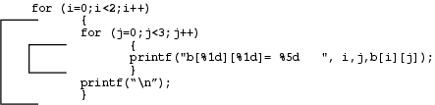
MULTIDIMENSIONAL ARRAYS
nested for loop to process all the elements of a multidimensional array
outer loop loops over rows and inner loop process all the columns

Slide 39
Example3: display the following matrix.
  1 1 1 1 1
    2 1 1 1 1
    A= 3 2 1 1 1
    4 3 2 1 1
    5 4 3 2 1
3-2+1
Analysis：
Use two dimensional array to store matrix data.
The rules of each element value:
  Row-subscript <= column-subscript:
  value=1;
  Row-subscript > column-subscript:
  value= row-subscript – column-subscript +1

Slide 40
#include <stdio.h>
void main( ) {
int i, j, a[5][5];
for (i=0; i<=4; i++) /* i for row subscript */
{
for (j=0; j<=4; j++) /* j for column subscript */
{
if ( i<=j ) a[i][j]=1; /* create matrix */
else a[i][j]=i-j+1;
}
}
for (i=0; i<=4; i++) /* display matrix */
{
for (j=0; j<=4; j++)
printf("%d ", a[i][j]);
printf("\n");
}
}

Slide 41
Example4: Get the reverse matrix (B) of matrix (A)
Matrix A(2×3), Reverse Matrix B(3×2)
  ┏ 1 2 3 ┓ ┏ 1 4 ┓
  Ａ＝ ┃ ┃ Ｂ＝ ┃ 2 5 ┃
  ┗ 4 5 6 ┛ ┗ 3 6 ┛
Algorithm for reversing matrix： b[j][i] = a[i][j]
#include <stdio.h>
void main( )
{ int i, j, b[3][2], a[2][3] = { {1,2,3}, {4,5,6} };
  for (i=0; i<=1; i++)
  for (j=0; j<=2; j++)
  b[j][i] = a[i][j]; /* reversing matrix */
  for (i=0; i<=2; i++) {
  for (j=0; j<=1; j++)
  printf("%d ", b[i][j]);
  printf(”\n”);
  }
  }

Slide 42
Example5 - 统计成绩
某班期终考试科目为高等数学(MT)、英语(EN)和物理(PH)，有30人参加考试。要统计并输出一个表格，包括学号、各科分数、总分、平均分，以及三门课均在90分以上者（该栏标志输出为“Y”，否则为“N”），表格形式如下：
NO MT EN PH SUM V >90
  -------------------------------------------------
  1 97 87 92 276 92 N
  2 92 91 90 273 91 Y
  3 90 81 82 253 84 N
  .....
Analysis：方法1:用a[30][4]存放学号和成绩,循环中的流程:
输出学号—求和并输出单科成绩—列循环结束输出和、平均分—判断90分以上并输出。

Slide 43
void main( )
{ int a[30][4], i, j, s=0; char c;
for (i=0; i<=29; i++) /* 输入30人的成绩 */
{ printf("Enter No. and score as: MT EN PH\n");
for (j=0; j<=3; j++)/* 输入学号和3门成绩 */
scanf("%d", &a[i][j]); }
printf(" NO. MT EN PH SUM V >90\n");
printf("-------------------------------------\n");
for (i=0; i<30; i++)/* 依次对30个人进行处理 */
{ printf("%4d:", a[i][0]);
for (s=0, j=1; j<=3; j++)
{ s += a[i][j];/* 计算3门课程总分 */
printf ("%4d", a[i][j]); }
if (a[i][1]>=90 && a[i][2]>=90 && a[i][3]>=90)
c='Y'; /* 若三门成绩均为90以上 */
else c='N';
printf(" %d %d %c\n", s, s/3, c);
}
}

Slide 44
NO MT EN PH SUM V >90
  -------------------------------------------------
  1 97 87 92 276 92 N
  2 92 91 90 273 91 Y
  3 90 81 82 253 84 N
  .....
Analysis：方法2:用a[30][4]存放学号和成绩,用SUM [30]存放总分，用V [30]存放平均分，流程如下：
输出学号—求和、求平均分—结束计算后输出a、 SUM、 V，平均分—判断90分以上并输出。并输出单科成绩

Slide 45
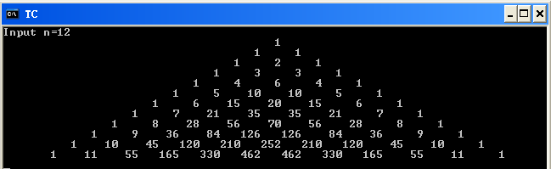
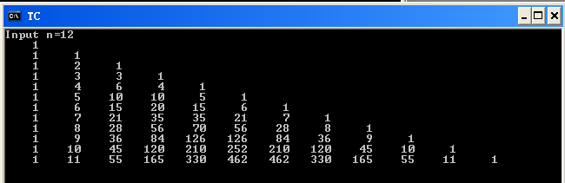
Example: Yang Hui Triangle

Slide 46
Example: Yang Hui Triangle
0 1 2 3 4 5 6 7 8 9
1
1 | 1
1 | 2 | 1
1 | 3 | 3 | 1
1 | 4 | 6 | 4 | 1
1 | 5 | 10 | 10 | 5 | 1
1 | 6 | 15 | 20 | 15 | 6 | 1
1 | 7 | 21 | 35 | 35 | 21 | 7 | 1
1 | 8 | 28 | 56 | 70 | 56 | 28 | 8 | 1
1 | 9 | 36 | 84 | 126 | 126 | 84 | 36 | 9 | 1
0 1 2 3 4 5 6 7 8 9

Slide 47
Example: Yang Hui Triangle
  #define SIZE 10
  main()
  { int i,j; int a[SIZE][SIZE];
  printf(“\n”);
  for (i=0; i<SIZE; i++)
  { a[i][0]=1; a[i][i]=1; }
  for (i=2; i<SIZE; i++)
  for (j=1;j<i;j++)
  a[i][j]=a[i-1][j-1]+a[i-1][j];
  for (i=0;i<SIZE;i++)
  { for (j=0;j<=i;j++)
  printf(“%5d”,a[i][j]);
  printf(“\n”);
  }
  }

Slide 48
Example: Saddle Point Problems of 2D Arrays
0 1 2 3 4 5 6 7 8 9
12 | 10 | 24 | 17 | 29 | 19 | 52 | 68 | 90 | 75
11 | 21 | 21 | 12 | 45 | 67 | 89 | 10 | 89 | 48
13 | 15 | 32 | 22 | 25 | 27 | 80 | 93 | 97 | 70
37 | 42 | 14 | 70 | 5 | 3 | 2 | 29 | 70 | 87
19 | 20 | 40 | 21 | 34 | 18 | 32 | 12 | 42 | 16
16 | 17 | 56 | 70 | 16 | 1 | 2 | 67 | 57 | 21
56 | 47 | 39 | 60 | 22 | 33 | 60 | 1 | 72 | 31
67 | 9 | 36 | 67 | 43 | 38 | 20 | 11 | 77 | 42
75 | 8 | 16 | 45 | 34 | 2 | 15 | 52 | 80 | 53
49 | 36 | 39 | 21 | 45 | 7 | 8 | 60 | 63 | 61
0 1 2 3 4 5 6 7 8 9

Slide 49
Example: Saddle Point Problems of 2D Arrays
  #define N 20
  #define M 20
  #include<stdio.h>
  #include<conio.h>
  void main( )
  {
  int a[N][M]; //int a[][]; not allowed here
  int i,j,k,row,col,n,m,find=0;
  clrscr();
  printf(" Enter n & m: ");
  scanf("%d%d",&n,&m);
  printf(" Enter a[0][0]--a[%d][%d] ",n-1,m-1);

Slide 50
Example: Saddle Point Problems of 2D Arrays
  for (i=0;i<n;i++)
  for (j=0;j<m;j++)
  scanf("%d",&a[i][j]);
  printf(" The array you have just entered is: ");
  for (i=0;i<n;i++)
  { for (j=0;j<m;j++)
  printf("%5d",a[i][j]);
  printf(" ");
  }

Slide 51
Example: Saddle Point Problems of 2D Arrays
  //find the point
  for (i=0;i<n;i++)
  { for (col=0,j=1;j<m;j++)
  if (a[i][col]<a[i][j])
  //find col,select sort according to col
  col=j;
  for (row=0,k=1;k<n;k++)
  if (a[row][col]>a[k][col])
  //find row,select sort according to row
  row=k;

Slide 52
Example: Saddle Point Problems of 2D Arrays
  if (i==row)
  { find=1;
  printf("The point is a[%d][%d]. ",row,col);
  }
  }
  if (!find)
  printf(" No solution. ");
  getch();
  }

Slide 53
FUNCTIONS AND 1-D ARRAYS
when we passed simple variables between functions, we had only two choices
  copy the value of the simple variable
  pass the address of the variable
In passing the address, we allowed the function to modify the original variable’s value (call by reference)

Slide 54
#include <stdio.h>
void display(int);
void main()
{
int i;
int marks[]={55,65,75,56,78,78,90};
for(i=0;i<=6;i++)
display(marks[i]);
}
void display(int m)
{
printf(“%d ”,m);
}
Use marks[i] as argument
Use m as parameter

Slide 55

#include <stdio.h>
void twice_element(int);
void main()
{
int i;
int marks[]={55,65,75,56,78,78,90};
for(i=0;i<=6;i++)
twice_element (marks[i]);
for(i=0;i<=6;i++) printf(“%d ”,marks[i]);
}
void twice_element(int m)
{
m = m*2;
}
What is the output ?
Does the value
of element change?

Slide 56
#include <stdio.h>
int get_sum(int a[],int n);
void main()
{
int i,sum;
int marks[]={55,65,75,56,78,78,90};
sum = get_sum (marks, 6);
printf(“the sum is %d ”,sum);
}
int get_sum(int a[],int n)
{ int i,sum=0;
for(i=0;i<=n;i++) sum = sum+a[i];
return sum;
}
Passing the name of the array
The size of the array
Just like marks[i]

Slide 57

void main (void)
{
int i, a[10]={0,1,2,3,4,5,6,7,8,9};
double x, c[5]={2.,4.,6.,8.,10};
function1 (&a[5], a[8]);
function2 (c , 5);
x = function3 (c, 5);
printf ("\na[5]=%d\n", a[5]);
printf ("c[ ]=");
for (i=0; i<5; i++)
printf("%.1lf ", c[i]);
printf ("\nx = %.1lf", x);
}
void function1 (int *d, int e)
{
*d = 100 + e;
}
void function2 (double b[], int num_elem) {
int i;
for (i=0; i<num_elem; i++)
b[i] *= 10.;
}
double function3 (const double b[], int num_elem) {
int i;
double sum;
sum = 0.0;
for (i=0; i<num_elem; i++)
sum += b[i];
return (sum);
}
Program output (note array c
changed to 10x)

Slide 58
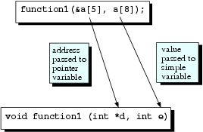
FUNCTIONS AND 1-D ARRAYS
To pass single array element to a function, we treat it just like that of simple variable i.e. use & if we want to modify the array element in the function
function1(&a[5], a[8]);
passes address of a[5] and value of a[8]
Also in C, the address of the first element of an array is the same as the array name itself, i.e.
&a[0] = a
Copyright © 2012 by The McGraw-Hill Companies, Inc. Permission required for reproduction or display.

Slide 59
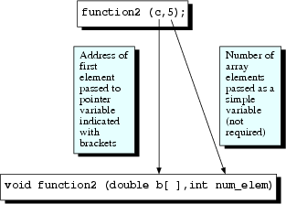
FUNCTIONS AND 1-D ARRAYS
To pass an entire 1D array to another function, we need only to pass the first element’s address to a function
C can internally calculate the address of any element of the array, thus enabling read/write access

Slide 60

FUNCTIONS AND 1-D ARRAYS
Function prototype therefore can be both
void function2 (double *b, int num_elem);
void function2 (double b[ ],int num_elem);
Recommend to use second format as it more clearly shows that we are working with arrays
Second parameter (num_elem) is the size of the array as C does not check the array bound
In some cases, we just want the function to read the array, we can use
Using const qualifier, C will indicate an error if the function attempt to modify the array
Copyright © 2012 by The McGraw-Hill Companies, Inc. Permission required for reproduction or display.

Slide 61
To pass multidimensional array to a function
Similar to 1D - during function call, only array name is required
In function prototype/definition, except for the first pair of brackets, all of the brackets should be filled with their declared sizes.
Example
  int a[10][5];
  char b[10][5][8][3];
a prototype for a function, would be of the form:
  void function1 (. . . int a[ ][5]. . .);
  void function2 (. . . char b[ ][5][8][3]. . .);
Copyright © 2012 by The McGraw-Hill Companies, Inc. Permission required for reproduction or display.

Slide 62
#include <stdio.h>
int get_sum(int a[][4],int n);
void main()
{ int i,sum;
int a[3][4]={1,2,3,4,5,6,7,8,9,0,1,6};
sum = get_sum(a, 3, 4);
printf(“the sum is %d ”,sum);
}
int get_sum(int arr[][4],int row, int col)
{ int i,j,sum=0;
for(i=0;i<row;i++)
for(j=0;j<col;j++)
sum = sum+arr[i][j];
return sum;
}
Passing the name of the array
Colums of this array
Rows of this array
Just like a[i][j]

Slide 63
Bubble Sort
fundamental operation on arrays is sorting
  b[4] = {33, 44, 11, 22}
  Target:
  b[4] becomes {11, 22, 33, 44}
need to do a considerable amount of swapping of array element values
goal of writing sorting algorithms is to do this type of swapping efficiently
Bubble sort is a simple sorting algorithm
Copyright © 2012 by The McGraw-Hill Companies, Inc. Permission required for reproduction or display.

Slide 64
Sorting array
Bubble sort
  We would like to sort the elements in an array in an ascending order
sort
7
2
8
5
4
2
4
5
7
8

Slide 65
Sorting array
7
2
8
5
4
2
7
5
4
8
2
5
4
7
8
2
4
5
7
8
2
7
8
5
4
2
7
5
4
8
2
5
4
7
8
2
4
5
7
8
2
7
8
5
4
2
5
7
4
8
2
4
5
7
8
(done)
2
7
5
8
4
2
5
4
7
8
2
7
5
4
8

Slide 66
Sorting Arrays
Bubble sort
void sort(int a[], int size)
{ int i, j, temp;
for (i = size - 1; i >= 0; --i) /* counting down */
{ for (j = 0; j < i; ++j) /* bubbling up */
{ if (a[j] > a[j+1]) /* if out of order... */
{ /* ... then swap */
temp = a[j];
a[j] = a[j+1];
a[j+1] = temp;
}
}
}
}

Slide 67
Sorting Arrays
Using bubble sort
#include <stdio.h>
#define ARRAY_SIZE 5
void sort(int a[], int size);
int main()
{ int array[ARRAY_SIZE] = {7, 2, 8, 5, 4};
int i = 0;
sort(array, ARRAY_SIZE);
for (i = 0; i < ARRAY_SIZE; ++i) /* print the sorted array */
printf("%d ", array[i]);
return 0;
}

Slide 68

#define START 0
#define END 4
#define SIZE 10
void main (void){
int i, j, k, b[SIZE], c[SIZE];
int temp, max, wheremax=END-1, min, wheremin=START;
int a[END]={33,44,11,22};
for (i=START; i<END; i++) /* initialize arrays */
b[i] = c[i] = a[i];
/* bubble sort */
for (i=START; i<END; i++) {
for (j=START; j<END-i-1; j++)
{
if (b[j]>b[j+1])
{
temp = b[j+1];
b[j+1] = b[j];
b[j] = temp;
}
}
}
/* exchange maximum sort */
for (i=END-1; i>=START; i--) {
max = c[i];
for (j=i; j>=START; j--) {
if (max<=c[j]) {
max = c[j];
wheremax = j;
}
}
c[wheremax] = c[i];
c[i] = max;
}
/* print results */
for (i=START; i<END; i++)
printf ("i=%1d, a[i]=%2d, b[i]=%2d, c[i]=%2d\n", i, a[i], b[i], c[i]);
}
Output

Slide 69
Bubble Sort
During the first pass, the largest element, 44, bubbles down and stops in the last element of the array
In general, need N-1 pass where N is number of data to be sorted
Copyright © 2012 by The McGraw-Hill Companies, Inc. Permission required for reproduction or display.

Slide 70
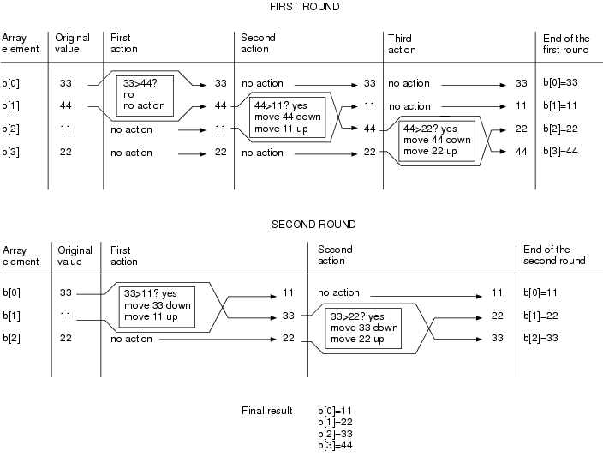
CSC1510 COMPUTER PRINCIPLE & C PROGRAMMING

Slide 71
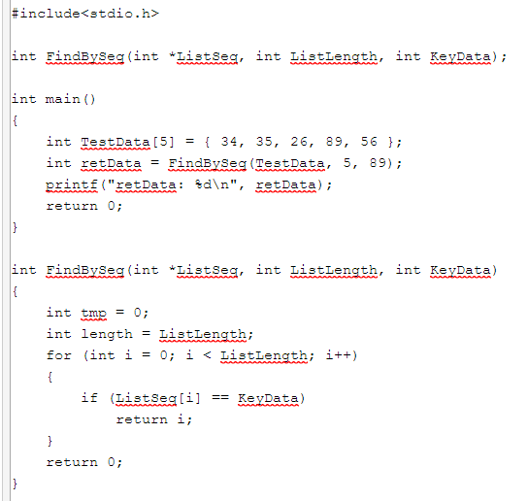

Slide 72
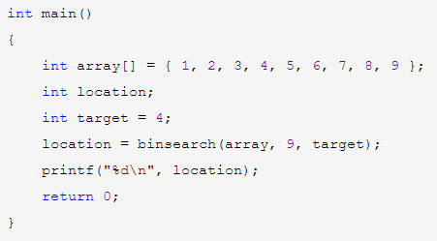

Slide 73
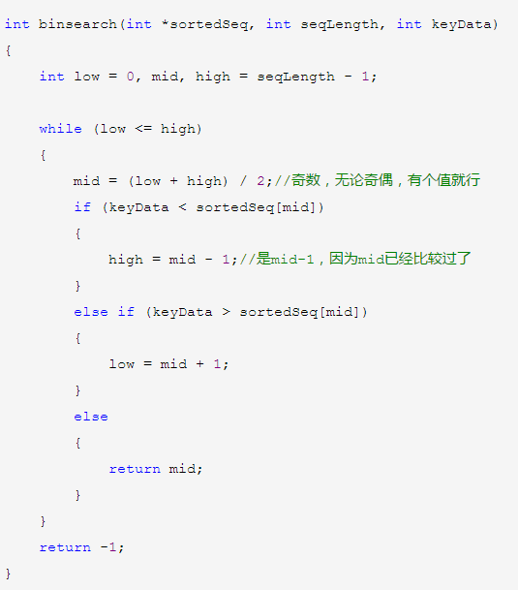

Slide 74
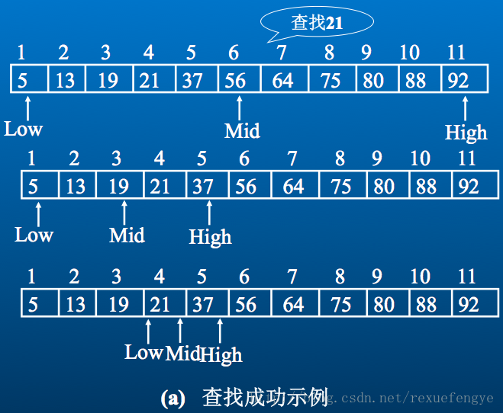

Slide 75
Thank you!
Q & A

